Slide 1
Propositional Logic (cont.)
Course Code: CSC 1204
Course Title: Discrete Mathematics
Dept. of Computer Science
Faculty of Science and Technology
Lecturer No: | 2 | Week No: | 1 | Semester: | Summer 20_21
Lecturer: | Nazia Hossain

Slide 2
Lecture Outline
1.1 Propositional Logic
Logic
Propositional Logic
Propositions
Propositional Variables * We have already covered
Compound Propositions
Logical Operators
Truth Value
Truth Tables of Compound Propositions
Conditional Statements
Logic and Bit Operations

Slide 3
Objectives and Outcomes
Objectives: To understand how to construct a truth table for a compound proposition, to understand the conditional statement p → q and different equivalent expressions of p → q , to understand bit operations.
Outcomes: Students are expected to be able construct a truth table for a given compound proposition, be able to explain the conditional statement p → q and it’s equivalent expressions, be able to perform Bit Operations.

Slide 4
Conditional Statements
Let p and q be propositions.
The conditional statement p → q is the proposition “if p, then q.”
The conditional statement p → q is false when p is true and q is false, and true otherwise.
In the conditional statement p → q, p is called hypothesis and q is called conclusion.
This one is the English usage of “if, then” or “implies”.
The connective → is called the ‘conditional connective’.
A conditional statement is also called an implication.

Slide 5
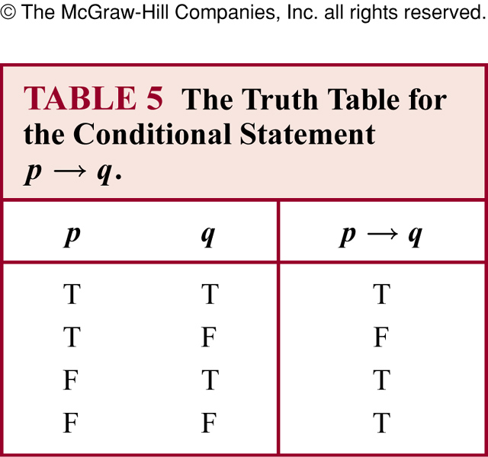
Truth Table for Conditional Statement

Slide 6
P : I win the election-> F
Q: I will build a huge library -> F
P -> Q: If P, then Q
If I win the election, then
I will build a huge library

Slide 7
Equivalent Expression of p → q
In terms of words, the proposition p → q also reads:
(a) if p, then q, or
if p, q
(The word “then” is sometimes omitted in English sentences)
(b) p implies q
(c) p is a sufficient condition for q , or
a sufficient condition for q is p
(d) q is a necessary condition for p, or
a necessary condition for p is q

Slide 8
Equivalent Expression of p → q
(e) p only if q
(f) q if p , or
q, if p
(g) q whenever p
(h) q when p
(i) q unless ¬p

Slide 9
Remember!
The hypothesis expresses a sufficient condition
The conclusion expresses a necessary condition
“but” is a logical synonym for “and”
“when” / “whenever” means the same as “if”
The hypothesis is the clause following “if”
The conclusion is the clause following “then”
“only if” clause is the conclusion
If hypothesis, then conclusion

Slide 10
Example 7 (page 7)
Let p : "Maria learns discrete mathematics" and q : "Maria will find a good job." Express the statement p → q as a statement in English.
Solution:
"If Maria learns discrete mathematics, then she will find a good job.“
There are many other ways to express this conditional statement in English.
"Maria will find a good job when she learns discrete mathematics”
"For Maria to get a good job, it is sufficient for her to learn discrete
mathematics”.
"Maria will find a good job unless she does not learn discrete
mathematics.”

Slide 11
Exercise 19
Write each of these statements in the form “if p, then q” in English.
It snows whenever the wind blows from the northeast.
Ans. If the wind blows from the northeast, then it snows
b) The apple trees will bloom if it stays warm for a week.
Ans. If it stays warm for a week, then the apple trees will bloom

Slide 12
Exercise 19
c) That the Pistons win the championship implies that
they beat the Lakers.
Ans. If the Pistons win the championship, then they beat
the Lakers.
d) It is necessary to walk 8 miles to get to the top of
Long’s Peak.
Ans. If you get to the top of Long’s Peak, then you must
have walked eight miles.

Slide 13
Exercise 19
e) To get tenure as a professor, it is sufficient to be world-
famous.
Ans. If you are world-famous, then you will get tenure as a
professor.
f) If you drive more than 400 miles, you will need to buy
gasoline.
Ans. If you drive more than 400 miles, then you will need to buy gasoline.

Slide 14
Exercise 19
g) Your guarantee is good only if you bought your CD
player less than 90 days ago.
Ans. If your guarantee is good, then you must have bought
your CD player less than 90 days ago.
h) Jan will go swimming unless the water is too cold.
Ans. If the water is not too cold, then Jan will go swimming.

Slide 15
Converse, Contrapositive, and Inverse
We can form some new conditional statements starting with a conditional statement p → q
The Converse of p → q is the proposition q → p
The Contrapositive of p → q is the proposition ¬ q → ¬ p
The Inverse of p → q is the proposition ¬ p → ¬ q

Slide 16
Examples of Converse, Contrapositive and Inverse
Converse: p → q ==> q → p
Example: “If it is noon, then I am hungry.”
Converse: “If I am hungry, then it is noon.”
Contrapositive: p → q ==> ¬q → ¬p
Example: “If it is noon, then I am hungry.”
Contrapositive: “If I am not hungry, then it is not noon.”
Inverse: p → q ==> ¬p → ¬q
Example: “If it is noon, then I am hungry.”
Inverse: “If it is not noon, then I am not hungry.”

Slide 17
Bi-Conditional
Let p and q be propositions.
The bi-conditional statement p ↔ q is the proposition “p if and only if q.”
The bi-conditional statement p ↔ q is true when p and q have the same truth values, and is false otherwise.
Bi-conditional statements are also called “bi-implications”
Question : Which operator is the opposite of ↔?
Answer: ↔ has exactly the opposite truth table as ⊕.

Slide 18
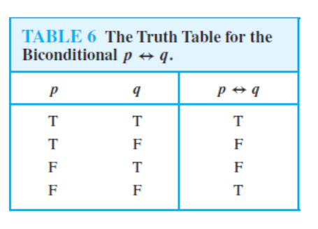
Truth Table for Bi-conditional p ↔ q

Slide 19
Example of Bi-conditional statement
Example 10 ( Page 9): Let p be the statement “ You can take the flight” and q be the statement “ You buy a ticket”. What is the statement for p ↔ q ?
Solution:
“You can take the flight if and only if you buy a ticket”

Slide 20
How to Construct a Truth Table for a Compound Proposition?
At first look at the number of propositions (e.g. p, q, r ) in the given compound proposition.
There will be 2^{n} number of rows in the truth table, where n is the number of propositions in the compound proposition.
Draw the table. In the first row, write down the name of propositions (e.g. p, q, r ) starting from left/first column.
Construct the truth table step by step.

Slide 21
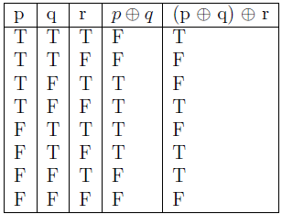
Example: Construct a truth table for (p ⊕ q) ⊕ r

Slide 22
Precedence of Logical Operators
Negation operator is applied before all other logical operators
Conjunction operator takes precedence over disjunction operator
Conditional and bi-conditional operators have lower precedence
Parentheses are used whenever necessary

Slide 23
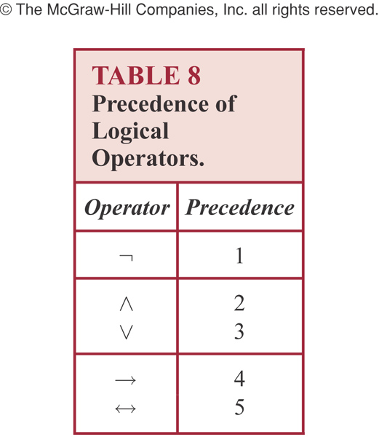
Precedence of Logical Operators

Slide 24
Logic and Bit Operations
bit ==> binary digit
Boolean variable: either true or false
Can be represented by a bit
Bit String: A bit string is a sequence of zero or more bits. The length of the string is the number of bits in the string.
Example 20(p.15): 101010011 is a bit string of length nine

Slide 25
Bit Operations
Computer bit operations correspond to the logical connectives. By replacing true by a one and false by a zero in the truth tables for the operators ∧, ∨, and ⊕, the tables shown in Table 9 for the corresponding bit operations are obtained. We will also use the notation OR, AND, and XOR for the operators ∨,∧, and ⊕ respectively, as is done in various programming languages.

Slide 26
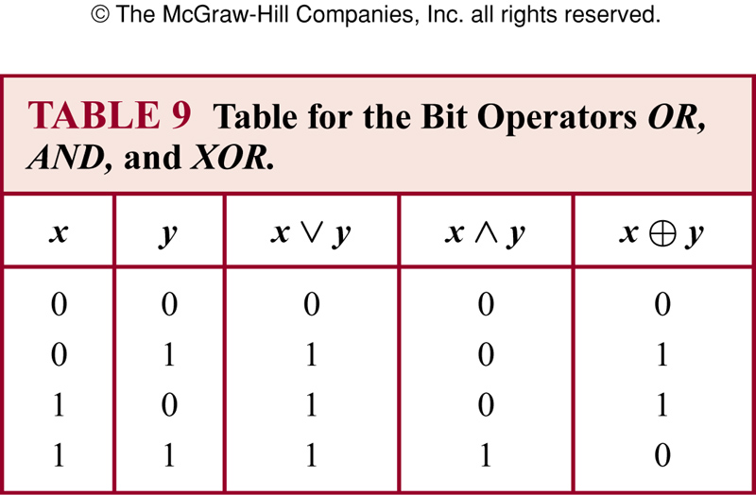
Table for Bit Operations

Slide 27
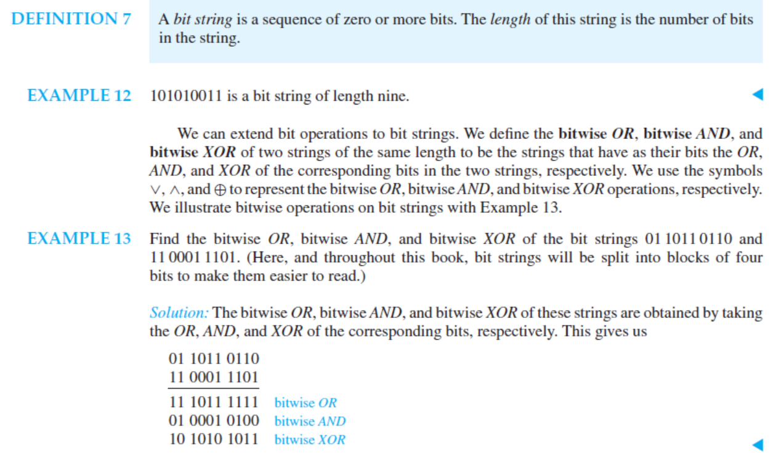
Bit string and bit operation

Slide 28
Books
Discrete Mathematics and its applications with combinatorics and graph theory (7th edition) by Kenneth H. Rosen [Indian Adaptation by KAMALA KRITHIVASAN], published by McGraw-Hill

Slide 29
References
Discrete Mathematics, Richard Johnsonbaugh, Pearson education, Inc.
Discrete Mathematical Structures, Bernard Kolman, Robert C. Busby, Sharon Ross, Prentice-Hall, Inc.
SCHAUM’S outlines Discrete Mathematics(2nd edition), by Seymour Lipschutz, Marc Lipson

